Slide 1


New York City Restaurant Inspections
Data-driven Analysis of Geography, Repeat Violations, and Cuisine Risk
Presenters: Sarika Gaind & Ali Shan Lakhani

Slide 2
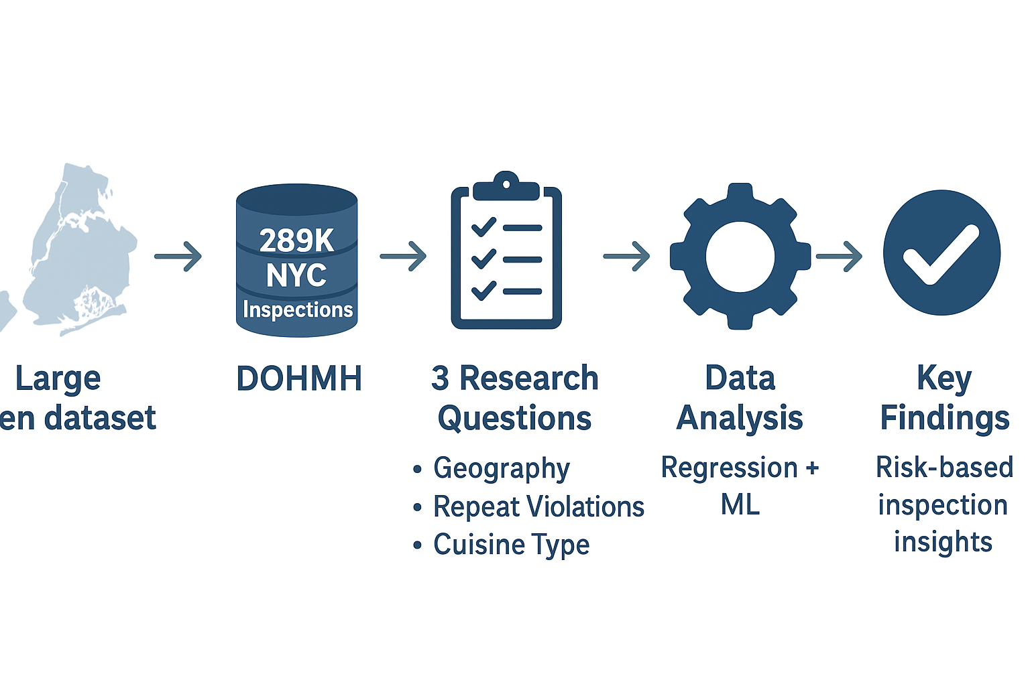
Background & Motivation
Analyzed over 289,000 NYC restaurant inspections from the Department of Health and Mental Hygiene (DOHMH) to study food safety patterns across the city.
Examined three key questions: how geography, repeat violations, and cuisine type influence inspection outcomes.
Results show geography explains very little variation in inspection scores performance depends mostly on restaurant hygiene practices.

Slide 3
Literature Review
Jin & Leslie (2009) – Inspection stringency varies geographically; consistency issues.
Kane et al. (2018) – Repeat violations often tied to managerial inattention, not location.
Filion & Powell (2011) – Cuisine-specific food-handling risks are under-researched.
Harrington (2016) – Predictive analytics can enhance food-safety enforcement. Gap Identified: few studies combine spatial, behavioral, and cuisine dimensions in one predictive framework.

Slide 4
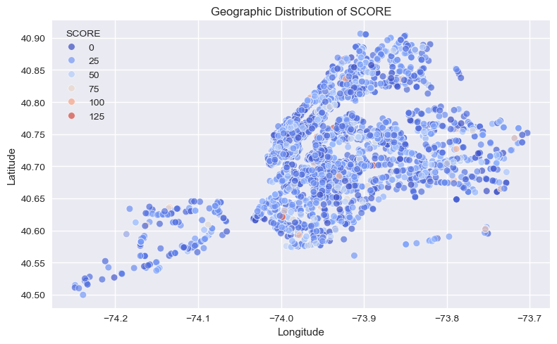
Dataset Overview
Source: NYC DOHMH Restaurant Inspection Results (≈ 289 k records × 27 features).
Variables include geography (BORO, ZIP CODE, latitude/longitude), establishment ID, inspection metadata, violation details, and score/grade outcomes.
Multi-inspection records per restaurant → aggregation and deduplication essential.

Slide 5
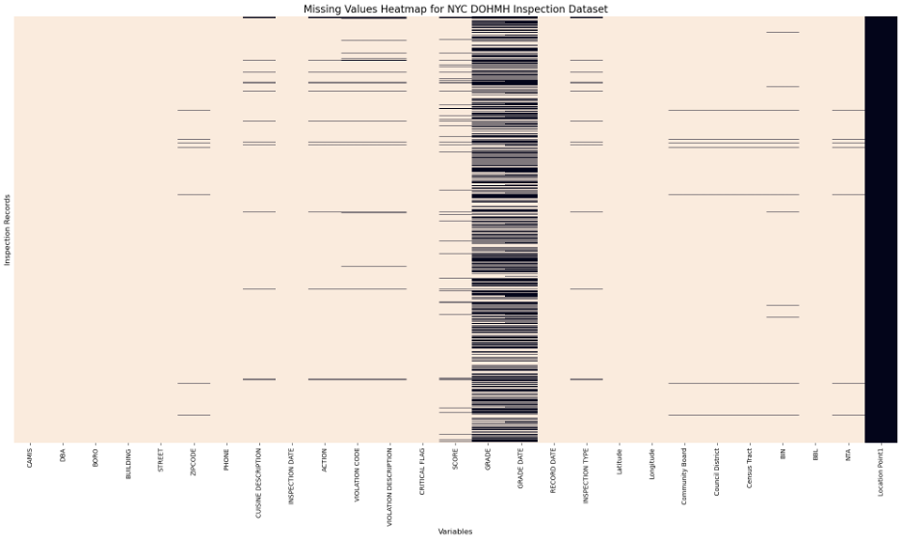
Exploratory Data Analysis

Slide 6
Data Cleaning & Preparation
Converted date fields to datetime, removed invalid coordinates (lat 40–41, lon −75 to −73).
Dropped missing core IDs (CAMIS, VIOLATION CODE).
Deduplicated exact inspection entries by ['CAMIS','INSPECTION DATE','VIOLATION CODE'].
Created SCORE_CLEAN (clipped ≤ 80) to reduce outlier impact.
Generated coarse spatial bins (lat_bin, lon_bin) for ~1 km precision.

Slide 7
Research Question 1 (RQ1): Geographic Determinants of Scores
Converted date fields to datetime, removed invalid coordinates (lat 40–41, lon −75 to −73).
Dropped missing core IDs (CAMIS, VIOLATION CODE).
Deduplicated exact inspection entries by ['CAMIS','INSPECTION DATE','VIOLATION CODE'].
Created SCORE_CLEAN (clipped ≤ 80) to reduce outlier impact.
Generated coarse spatial bins (lat_bin, lon_bin) for ~1 km precision.

Slide 8
Research Question 1 (RQ1) Results and Interpretation
Model | MAE | RMSE | R²
Gradient Boosting | 8.93 | 11.61 | 0.026
Ridge | 8.93 | 11.64 | 0.022
Linear | 8.94 | 11.66 | 0.019
Random Forest | 9.13 | 11.97 | −0.034
Geography explains ≈ 2–3 % of score variance → cleanliness is largely operational, not locational.
Confirms equity: similar scores across boroughs once individual management effects dominate.
Limitation: data lacks operational practice variables.
Notes:
Table to be added

Slide 9
Research Question 2 (RQ2): Repeat Violations - RQ2 Goal
Identify predictors of recurrent health-code issues. Two complementary targets:
Run 1 – repeat_same_flag: restaurant repeats the same violation code.
Run 2 – repeat_flag: restaurant shows ≥ 2 distinct violations (breadth). Independent vars: BORO, CUISINE DESCRIPTION, INSPECTION TYPE, CRITICAL FLAG, SCORE. Why these: jointly represent geography, cuisine context, enforcement phase, and risk level.
.
Notes:
Table to be added

Slide 10
Research Question 2 (RQ2): Techniques
Cleaned data → dropped missing essentials, stratified 80/20 split.
Preprocessing: OneHotEncoder + StandardScaler.
Models: Logistic Regression , Decision Tree , Random Forest , Gradient Boosting .
Evaluated Accuracy, Precision, Recall, F1, ROC-AUC.
Feature importance via Permutation Importance for best-accuracy model per run
.
Notes:
Table to be added

Slide 11
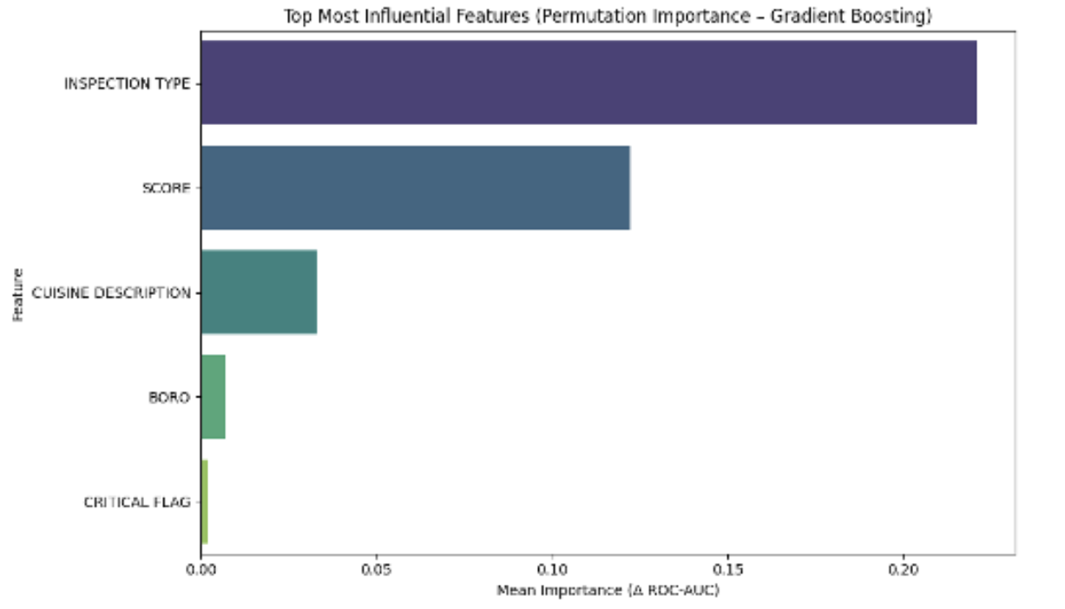
Model(Run 1) | Accuracy | Precision | Recall | F1-Score | ROC-AUC
Random Forest | 0.814 | 0.957 | 0.824 | 0.885 | 0.876
Logistic Regression | 0.757 | 0.947 | 0.765 | 0.846 | 0.815
Gradient Boosting | 0.887 | 0.903 | 0.976 | 0.938 | 0.848
Decision Tree | 0.726 | 0.960 | 0.715 | 0.820 | 0.833

Slide 12
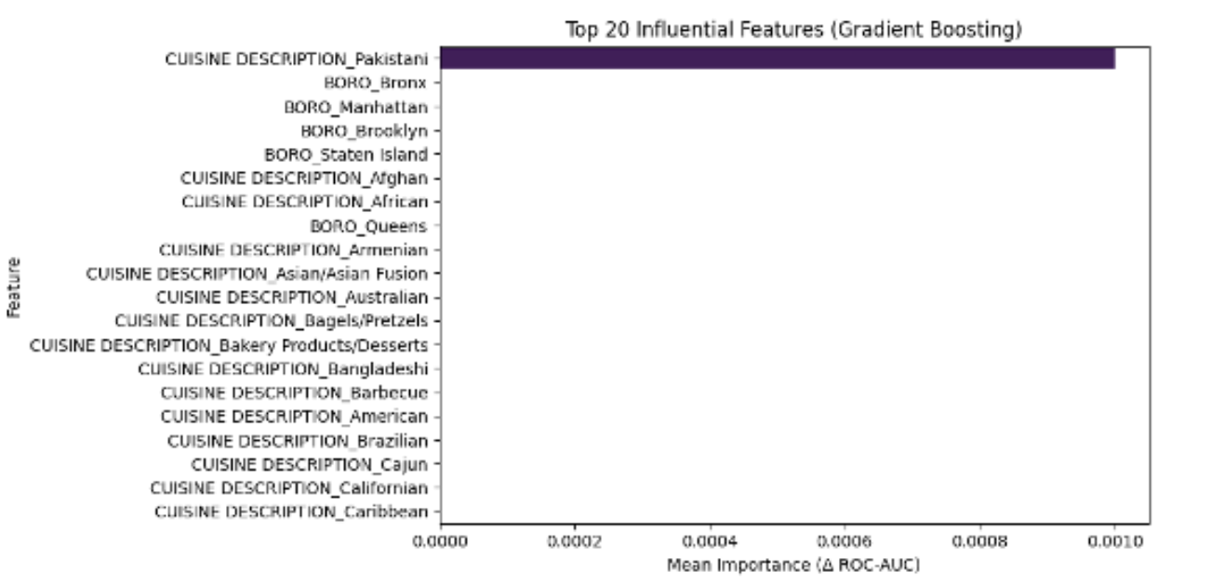
Model(Run 2) | Accuracy | Precision | Recall | F1-Score | ROC-AUC
Random Forest | 0.982 | 0.998 | 0.983 | 0.991 | 0.922
Logistic Regression | 0.914 | 1.000 | 0.914 | 0.955 | 0.968
Gradient Boosting | 0.996 | 0.998 | 0.999 | 0.998 | 0.923
Decision Tree | 0.943 | 1.000 | 0.943 | 0.971 | 0.975
Notes:
Table to be added

Slide 13
Research Question 3 (RQ3): Cuisine & Severe Violations
Question: Do cuisine types and geography predict severe (critical) violations?
Target: severe_violation (1 if CRITICAL FLAG contains “Critical”).
Features:
Categorical: cuisine_clean, BORO, NTA_clean, cuisine_boro, geo_cluster.
Numeric: Latitude, Longitude, cuisine_popularity.
Mutual-Information feature selection (top 50).
Balanced train via minority upsampling; models = LogReg, Tree, RF, GB.
.
Notes:
Table to be added

Slide 14
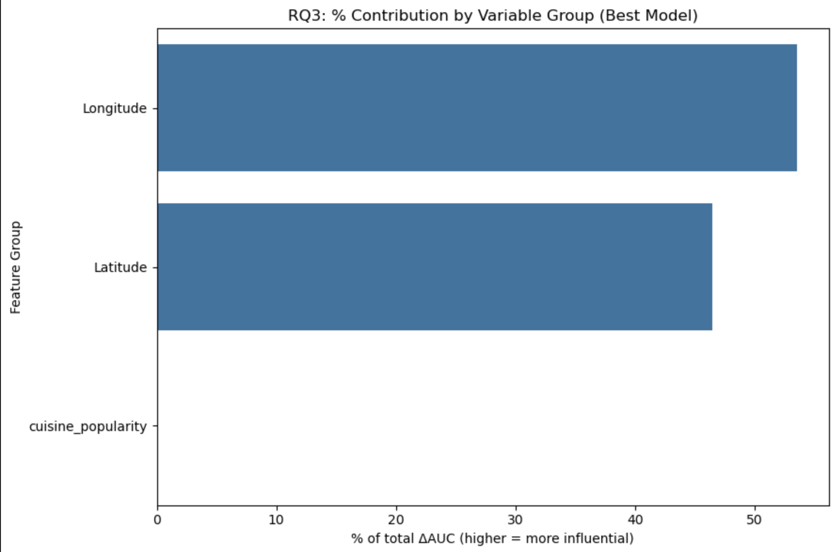
Model | Accuracy | Precision | Recall | F1-Score | ROC-AUC
Random Forest | 0.876 | 0.978 | 0.876 | 0.922 | 0.656
Logistic Regression | 0.600 | 0.976 | 0.600 | 0.738 | 0.576
Gradient Boosting | 0.662 | 0.977 | 0.662 | 0.785 | 0.618
Decision Tree | 0.736 | 0.977 | 0.736 | 0.836 | 0.595

Slide 15
Findings – RQ3 (Cuisine-Type Risks & Geography)
Severe (critical) violations are moderately predictable using cuisine + geographic context (best model: Random Forest, AUC ≈ 0.66).
Cuisine effects become meaningful only when combined with geography (e.g., cuisine × borough combinations show clear risk patterns).
Spatial risk is better captured using lat/long bins, neighborhood groups (NTA), and geo-clusters, since raw latitude/longitude alone behave as a paired coordinate, not separate predictors.
Cuisine categories are broad (fast-food to gourmet), which dampens individual cuisine influence, but cuisine popularity and regional patterns still carry risk signal.
Results suggest contextual risk, not absolute risk—useful for inspection prioritization, but not strong enough for public restaurant choices.
Notes:
Table to be added

Slide 16
Global Interpretation
RQ1: Geography alone ≈ no predictive power → cleanliness ≈ management quality.
RQ2: Behavioral repetition detectable → enforcement & risk score most informative.
RQ3: Cuisine & geography jointly signal moderate contextual risk. Practical meaning: predictions are directionally useful for health-dept prioritization, but not reliable enough for the public to choose a restaurant solely by model output.
.
Notes:
Table to be added

Slide 17
Opportunities for Improvement
If additional variables were available:
Operational metrics: staff training, ownership type, cleaning frequency.
Temporal features: seasonality, time since last inspection.
Text analytics: embedding violation descriptions to capture nuance. These could raise R² and ROC-AUC substantially and make forecasts actionable
.
Notes:
Table to be added

Slide 18
Conclusion & Implications
Geography minimally impacts scores; behavior & enforcement cycle matter most.
Predictive models can assist risk-based inspection scheduling.
Balanced modeling of repeat violations offers actionable early warnings.
Future research: integrate temporal, textual, and operational dimensions for richer insights.
.
Notes:
Table to be added

Slide 19
Thank you!- Any Questions?
Notes:
Table to be added

